Slide 1
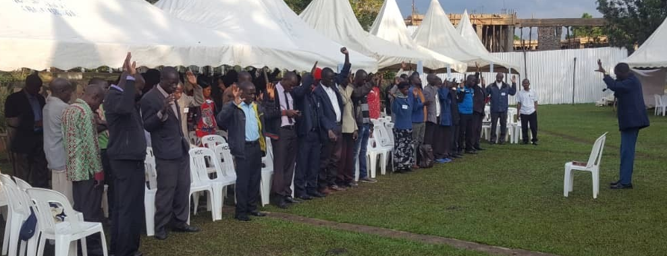
After these things I looked, and behold, a great multitude which no one could number, of all nations, tribes, peoples, and tongues, standing before the throne and before the Lamb, clothed with white robes, with palm branches in their hands, (Revelation 7:9)
All Scripture is taken from the New King James Version®. © 1982 by Thomas Nelson, Inc. Used by permission. All rights reserved.
Cultural and Social Considerations

Slide 2
But why do you judge your brother? Or why do you show contempt for your brother? For we shall all stand before the judgement seat of Christ… Therefore let us not judge one another anymore, but rather resolve this, not to put a stumbling block or a cause to fall in our brother’s way (Rom. 14:10, 13).
All things are lawful for me, but not all things are helpful; all things are lawful for me, but not all things edify. Let no one seek his own, but each one the other’s well-being
(1 Cor. 10:23-24).

Slide 3
?

Slide 4
1 Chronicles 29:9
Then the people rejoiced, for they had offered willingly, because with a loyal heart they had offered willingly to the Lord; and King David also rejoiced greatly.

Slide 5
Matthew 23:12
And whoever exalts himself will be humbled, and he who humbles himself will be exalted.

Slide 6
Exodus 35:29
The children of Israel brought a freewill offering to the Lord, all the men and women whose hearts were willing to bring material for all kinds of work which the Lord, by the hand of Moses, had commanded to be done.

Slide 7
Ephesians 2:10
For we are His workmanship, created in Christ Jesus for good works, which God prepared beforehand that we should walk in them.

Slide 8
1 Corinthians 16:17
I am glad about the coming of Stephanas, Fortunatus, and Achaicus, for what was lacking on your part they supplied.

Slide 9
Proverbs 1:5
A wise man will hear and increase learning, And a man of understanding will attain wise counsel,

Slide 10
Matthew 18:4
Therefore whoever humbles himself as this little child is the greatest in the kingdom of heaven.

Slide 11
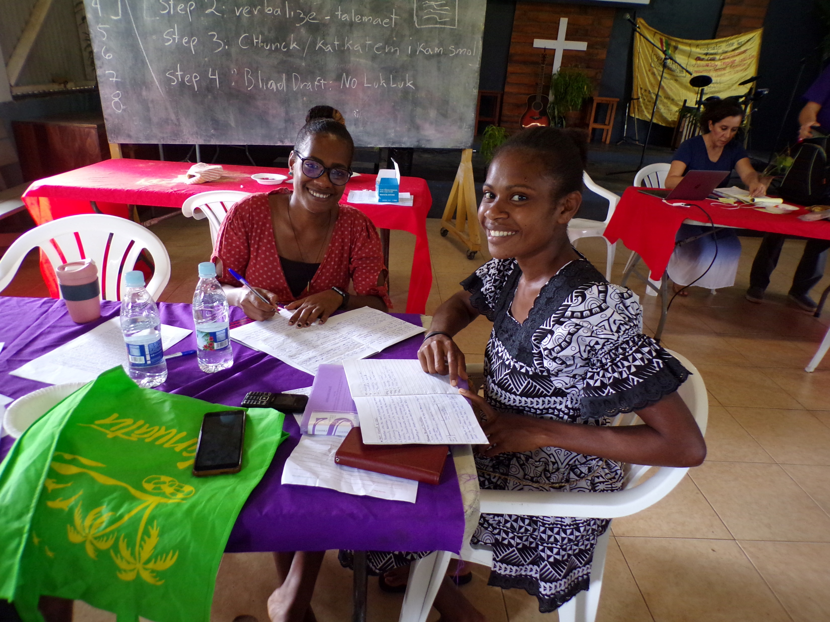
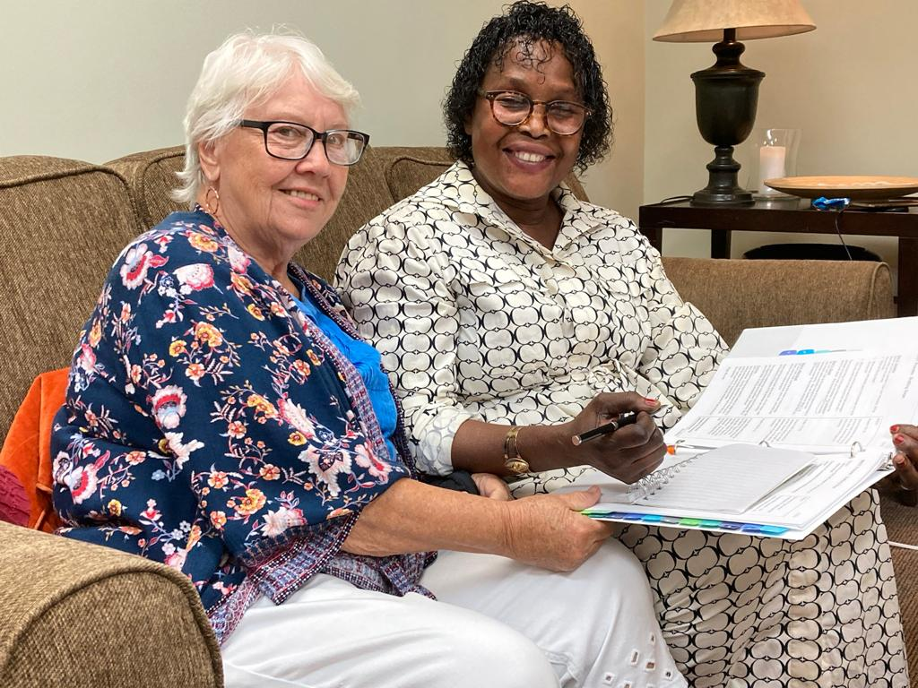
WHO
we have in common
is more important
than all our differences.

